Slide 1
PARENT GUIDE: BUZZING FOR SUCCESS!
The Way Forward for Success!

Slide 2
Ministry of Education Masa-Aki N. Emesiochl
College Access Grant Resources

Slide 3
RESOURCES
My Future, My Way: How to go, How to Pay: A Workbook for Students in Middle and Junior High Schools by the U.S. Department of Education, Financial Student Aid
Funding Education Beyond High School by the U.S. Department of Education, Financial Student Aid
Parent Power: Build the Bridge to Success by the U.S. Department of Education
A Best Practices Guide for College Access from the Ministry of Education, Palau.
Student Guides for 7th, 9th and 12th grade students;
“Getting Ready for College” Tabloid
A College Access Website: http://www.palaumoe.net/cacg; and
Additional Resources

Slide 4
COLLEGE ACCESS IN PALAU
The College Access efforts of the Ministry of Education is to help students and parents.
Help parents and family members to:
create and strengthen a college-going culture in your home;
help you support what is going on in your child’s classroom and school; and
improve what is needed to ensure opportunities for your child to complete a college education.

Slide 6
Happiest People
live according to their own values
have a very clear sense of who they are
expect to have a positive impact on the world
see their work as meaningful
create their own work life, filling in with skills, and persisting to what they want

Slide 7
The best gifts parents can give to their child are Roots and Wings.
–Chinese Proverb
You are the bows from which your children as living arrows are sent forth. -Khalil Gibran

Slide 8
WHY COLLEGE OR ADVANCED TRAINING?
Intellectual
Developmental
Financial
Notes:
Intellectual
Exposure to exciting new ideas and areas of study
Increased skills in reading, writing, math, and analysis
Opportunities to work alongside professors doing cutting-edge research
Ability to increase your knowledge of the world, your own and different cultures, and career options
Developmental
Increase in maturity and independence due to students’ having complete responsibility for their academic career
Learning to be tolerant of differences due to being exposed to a vast array of cultures, philosophies, and ways of life
Experiencing a wide variety of student activities including the opportunity to tutor, mentor, and study in another country
Developing skills for successfully transitioning to adulthood and the world of work
Financial
Exposure to career and life experiences through internships and fellowships
Increase in earning capacity – A four-year college graduate earns almost $1 million dollars more over his or her lifetime than a high school graduate. The average annual income of a four-year college graduate is about $52,180, compared to the average annual income of $30,940 for a high school graduate.
.Better working conditions, including longer job tenure, more on-the job training opportunities, and more responsibility and promotion opportunities

Slide 9
What a Parent Can Do!
Nurture Your Child’s Inner Spirit
Provide Guidance
Communicate Effectively
Form a Strong Connection
Empower Your Child
Notes:
Start with the idea that we as PARENTS do try to encourage our children but sometimes need to consciously think and do! Then, talk about each step, but use examples not typically thought of.
Under nurture….know and appreciate you child for BEING an individual….support their ideas
Under guidance ….. compassion and tolerance we sometimes forget…a little sympathy can go a long way!
Under communications…. Practice active listening
Under connection…Make time to do things together
Under empower…believe in his/her ability to make good decisions

Slide 10
Elementary School:
Be an Example: Tell about what you do, how you do it and how you got to this point in your life!
Stress that we all have “a job” at every age and level…is it what we want!
Parent Conferences
Parent-Teacher Groups
Volunteer at School
Help at Home

Slide 11
A Home with a College-Going Culture
They receive positive and consistent messages about the importance of their goals and academic achievement.
Adult “talk” or “buzzing” around our children should include where and how—not if —they are going to continue their education after high school.
Beginning at an early age, we can begin to talk to our children about their goals, educational options, and career opportunities in concrete and positive ways they can understand.
Notes:
For example, going to the doctor can become an opportunity to talk to your child about what a doctor does in his/her job, as well as how many years of school people need to become doctors.

Slide 12
Does the School Have a College-Going Culture?
career exploration and understanding what kind of education each career requires.
expectation that all students can prepare for and be successful in post-secondary education.
message of having high expectations for their success in the future.

Slide 13
Planning for College
Step 1: Talk about college.
Step 2: Take the right classes
Step 3: Begin with the end in mind.
Step 4: Know the college options.
Step 5: Find money for college.

Slide 14
Every Year Start and Don’t Stop:
Save money!
Classes and Tests
Know What Is Happening at School
Encourage your child to see the guidance counselor
Help your child stay focused on school work
Be active in your children's school
Encourage your child to participate in music, art, clubs, and athletics programs - leadership

Slide 16
Educational Opportunities in the Summer
Limit TV, video games, and computer networking.
Encourage your child to read more
and do word games.
Help your child understand the importance of math and science
Gifts to include educational games, books, and hobby supplies.
Help your child think about the types of careers
Educational, learning and fun activities
Notes:
. Start an environmental project and discuss with your child how science and research can help save the water, fish, land, etc.

Slide 17
Preparing for the World of Work

Slide 18
Preparing for the World of Work
Support learning, encourage hard work, and be an example of someone committed to excellence.
Discuss job options and how job choices can affect lifestyles
Support dreams with follow-up activities
Consider extra lessons and training
Discuss interviewing, thinking like an employer, and how to communicate skills and experiences clearly
Encourage planning and thinking ahead
Talk about managing money and how money spent is related to the time required to earn it.
Develop responsibility by expecting teens to do chores and homework on their own.
Be supportive of effort, as well as achievement, and teach young people to be proud of trying.
Be a good example by genuinely appreciating other people and enjoying life.
Notes:
Make sure the child has chores and finishes them.
How we “talk” and react to different people in different jobs impacts our children…example people do make great living as McDonald’s managers!!! It is not all about “flipping hamburgers”

Slide 19
Specific Grade Levels: 8th Grade
Help your 8th grader select 9th grade courses that will put her/him on track to be college-ready.
Encourage your child to take the pre-tests and self-assessments no later than the 8th grade if possible.
Explain about “keeping and documenting” volunteer work, awards, successful activities. Start a portfolio!

Slide 20
Specific Grade Levels: 9th Grade Career and College Prep
Career planning and the information on the MOE website and others
Types of careers that interest him/her, and learn about the skills needed to succeed in that career.
Job shadowing opportunities
Exploration process to learn about colleges and the requirements – it’s not too early.
Review the “Getting Ready for College” Tabloid from the MOE
Review/discuss the “Student Guide” and how those activities and ideas are helping in such decision making
Add to the portfolio!

Slide 21
Specific Grade Levels: 10th Grade
Select 11th grade courses that will keep her/him on track to be college-ready.
Take the PSAT and/or other similar tests in the 10th grade if possible!
Add to the portfolio! Document!

Slide 22
Specific Grade Levels: 11th Grade
Get started on the college search and decide which colleges to apply to attend now!
Review and share with you a good portfolio that is edited and improved.
Make college visits and check on colleges through their websites.
Start looking for scholarships now!

Slide 23
Specific Grade Levels: 11th Grade
Select 12th grade courses that will keep him/her on track to be college-ready
Takes the PSAT or other pre-assessment tests in the fall.
Sign up to take the ACT in the spring of 11th grade.

Slide 24
Specific Grade Levels: 12th Grade
Take tests used for college admission, course placement, and for scholarships
Practice tests beginning in 8th grade, and to take the ACT or SAT more than once
Narrow down which colleges he/she is interested in then get information and applications
Make decision as to which college is the final selection

Slide 25
Specific Grade Levels: 12th Grade
Submitted a letter of intent with application details
Make copies and keep
Re-take admittance tests
Meet with counselors to review high school transcript for accuracy and completion
Order copies of transcripts
Copies of an updated resume to teachers writing letters of recommendations
Accepted - then place deposits, fees and other required fees and costs in the mail

Slide 26
Specific Grade Levels: 12th Grade
File your (family) taxes as early in the spring semester
Complete the FAFSA (Free Application for Federal Student Aid)
Complete the application for state financial aid.

Slide 27
REMEMBER
Old enough to go to college, he/she is old enough to get things done – you just check!
Point out the plus/minus factors, but do not judge!
A college certificate, degree or even just courses, will not ensure employment once completed!

Slide 28
Must Have a Plan!
Doctor of Psychiatry usually takes 2 more years!
2-years beyond 4-year degree for school counselor or psychologists certification! Higher level employment while continuing to the Doctorate level of Psychiatrist!
4-year degree in teaching - higher level employment while continuing to the psychologist/psychiatrist degree!
2-year certificate/degree as teacher aid - employment in schools while taking next steps!
Notes:
Could do through the medical route as well.

Slide 29
TIME IS NOW!
“The Guide to Federal Student Aid|2011-12,” U.S. Department of Education, Federal Student Aid from counselor’s office, PCC or from the www.ed.gov website
Senior Guide from MOE entitled, “HIGH SCHOOL SENIOR GUIDE - For A Successful Future!”
“Getting Ready for College” Tabloid from MOE
Visit MOE Website: http://www.palaumoe.net/cacg
Visit representatives at the Palau Scholarship Office
PCC Student Services Office

Slide 30
How to Afford College
Every problem has a way out, there are certain options which can help you in affording a college.

Slide 31
How to Afford the College Tuition
Free Application for Federal Student Aid (FAFSA)
Part-Time Jobs
Scholarships & Grants
Personal Loans

Slide 32
FEDERAL RESOURCES
STUDENT GUIDE – FINANCIAL AID 
FUNDING YOUR EDUCATION 
LOOKING FOR STUDENT AID
INSTRUCTIONS FOR COMPLETING THE FAFSA
Provide for All Students
Federal Student Aid Information Center 1-800-4-FED-AID (1-800-433-3243)
On-Line at http://www.ed.gov/prog_info/SFA/

Slide 33
Earning Money for College
Small Business for Students
Think it through – more than just fast foods!

Slide 34
Earning Money for College – Student Business
Tutoring:
Handmade Crafts and Items:
Note Taking:
Yard Work:
Freelancing (writing newspapers/doing photos/etc.)
Laundry Service:
Data Entry Jobs:
Entertainment

Slide 35
Other Small Business Ideas
Snack delivery business
Bakery service
Writing service

Slide 36
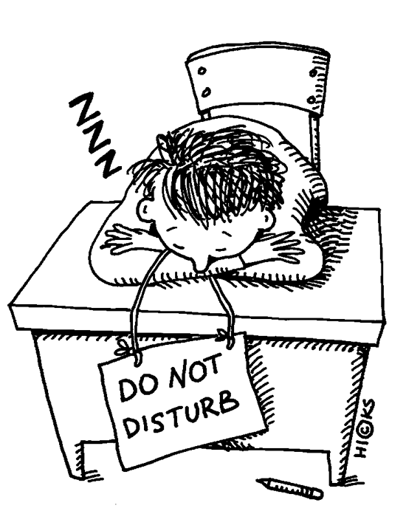
CAN DO!
A teen should utilize four years of his/her college in learning, gaining experience, becoming a better person and also enjoying life.
Notes:
ALSO enjoying life…not JUST enjoying life!

Slide 37
Any Questions?
THANK YOU!

